Slide 1
Configuration Guide
(WAS – Jeus 6.0.0.5
for codelabor-spring-mvc-template)
2009. 07. 21
CODELABOR
Shin Sang Jae (codelabor@gmail.com)

Slide 2

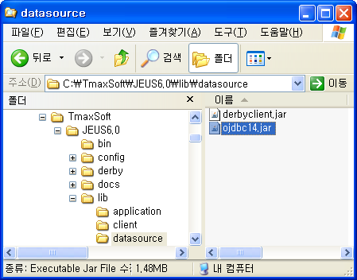
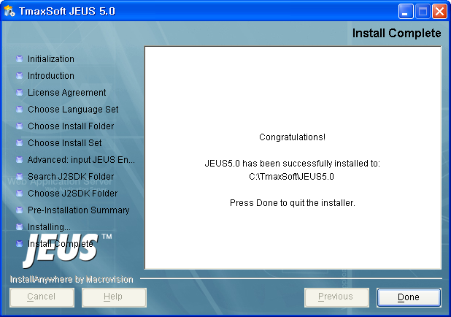
Jeus
Install JDBC Driver
Database: Oracle
JDBC Driver File: ojdbc14.jar
Install Directory: C:\TmaxSoft\JEUS6.0\lib\datasource

Slide 3
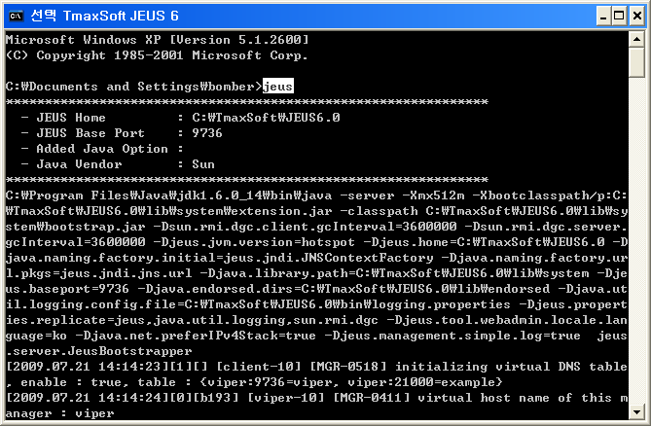
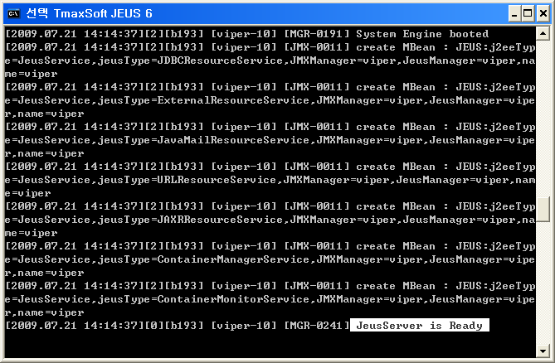
Jeus
Run Jeus Server
Run Jeus Server
Command: jeus

Slide 4
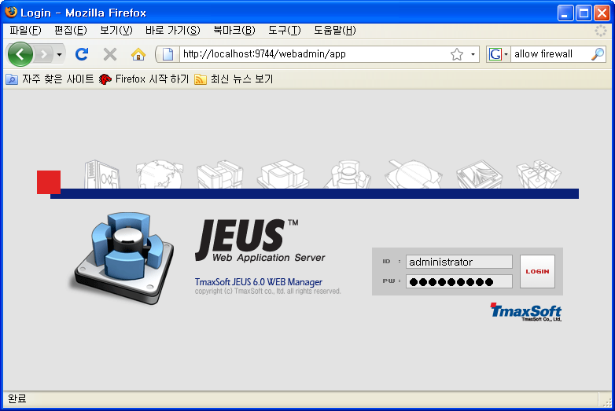
Jeus
Web Admin
Run Jeus WebAdmin
URL: http://localhost:9744/webadmin
ID: administrator
PW: jeusadmin

Slide 5
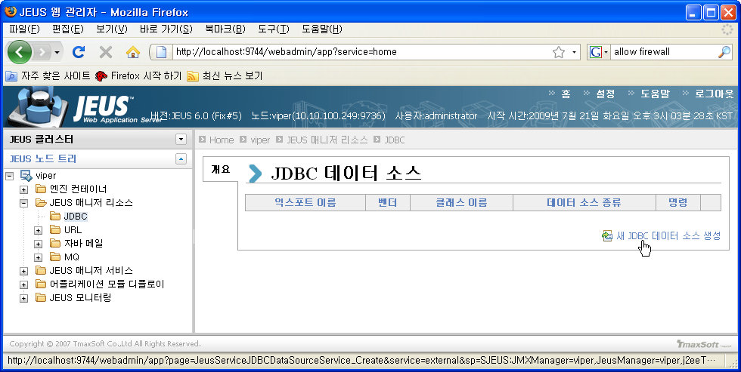
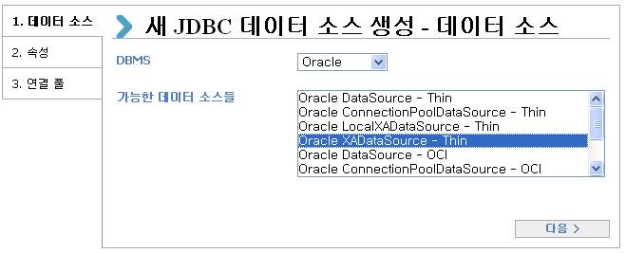
Jeus
JDBC DataSource
Left Pan: Node Name > JEUS 매니저 리소스 > JDBC
Right Pan: 새 JDBC 데이터 소스 생성
DBMS: Oracle
Data Source Type: Oracle XADataSource - Thin

Slide 6
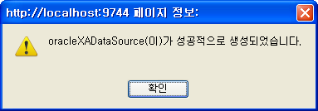
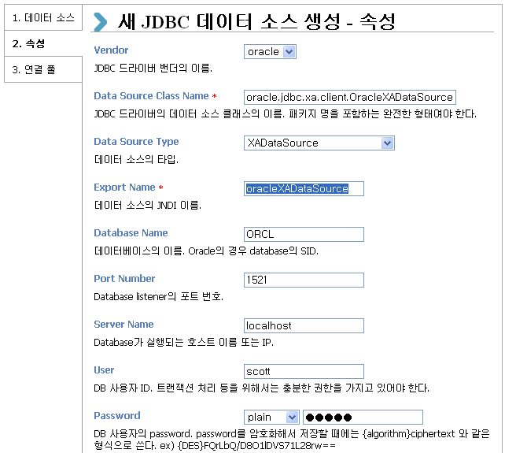
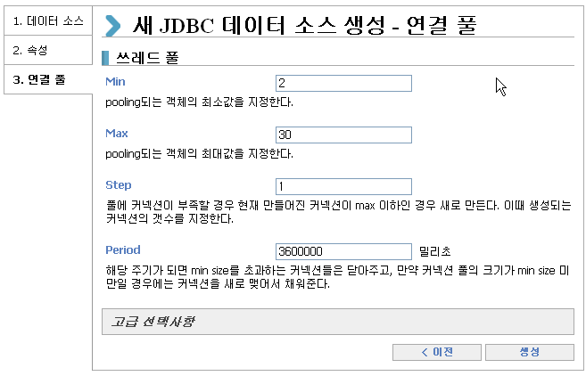
Jeus
JDBC DataSource
Export Name: oracleXADataSource
User: scott
Password: tiger

Slide 7
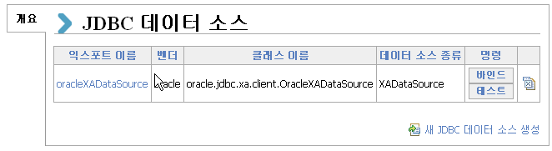
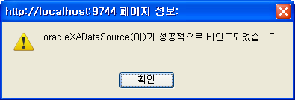
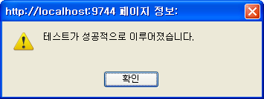
Jeus
Test DataSource
Bind / Test DataSource

Slide 8
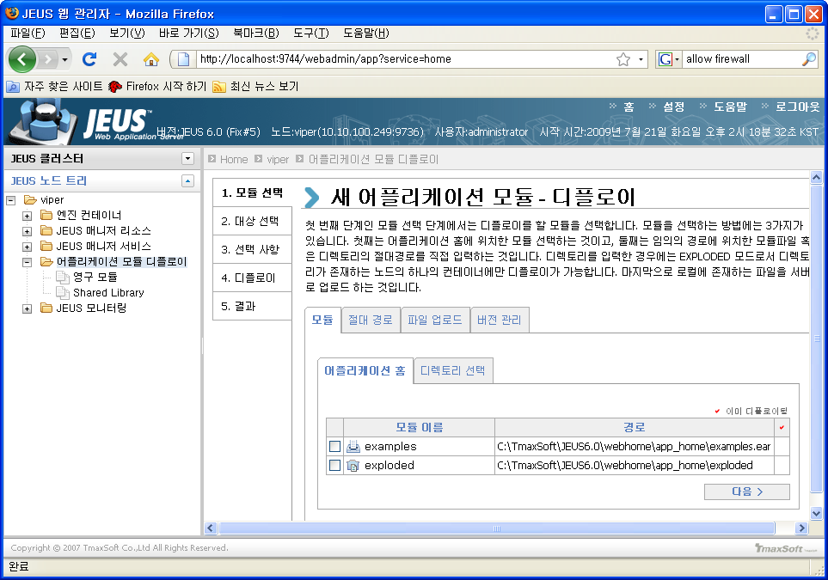
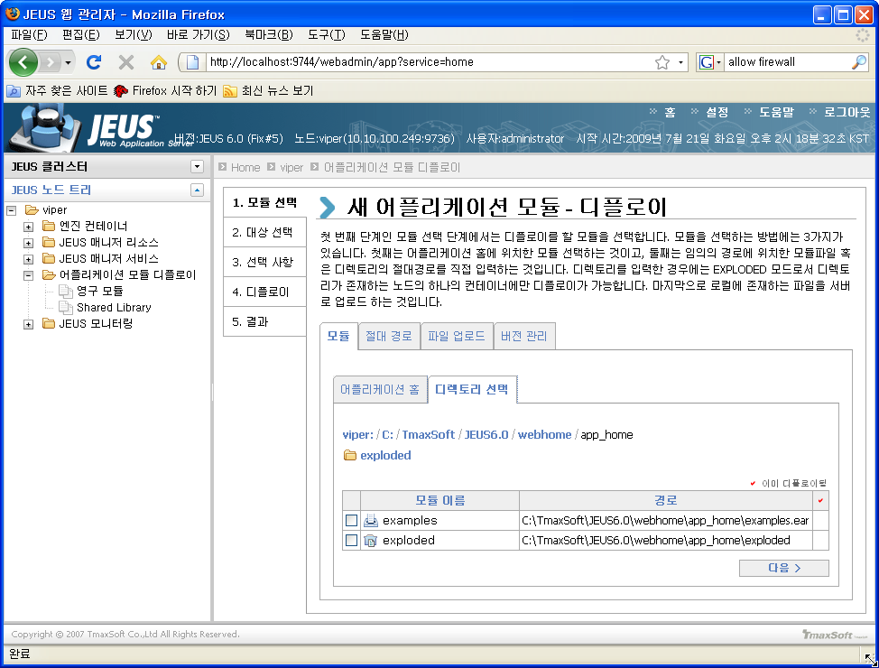
Jeus
Deploy Web Application
Left Pan: Node Name > 어플리케이션 모듈 디플로이
Right Pan: 모듈 선택 > 모듈 > 디렉토리 선택

Slide 9
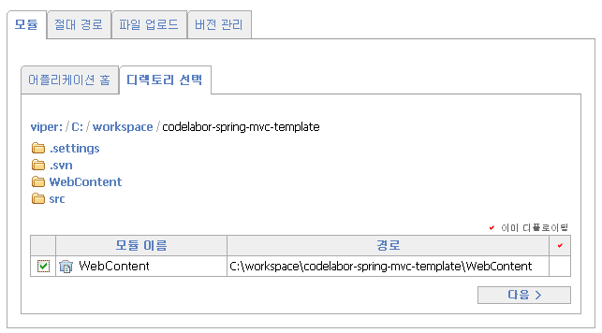
Jeus
Deploy Web Application
Change Directory
Directory: C:\workspace\codelabor-spring-mvc-template
Check WebContent
Next

Slide 10
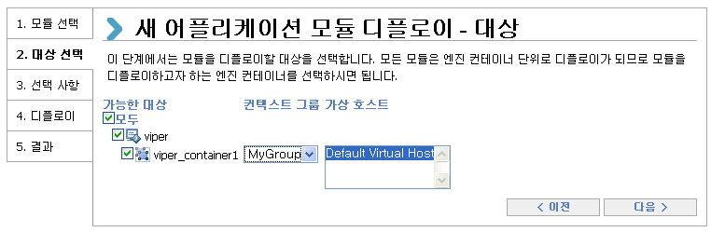
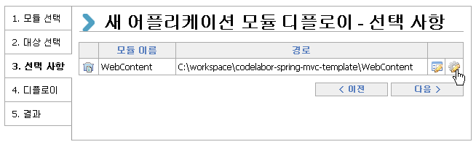
Jeus
Deploy Web Application
Select Target
Click Option (Toothed Wheel Button)

Slide 11
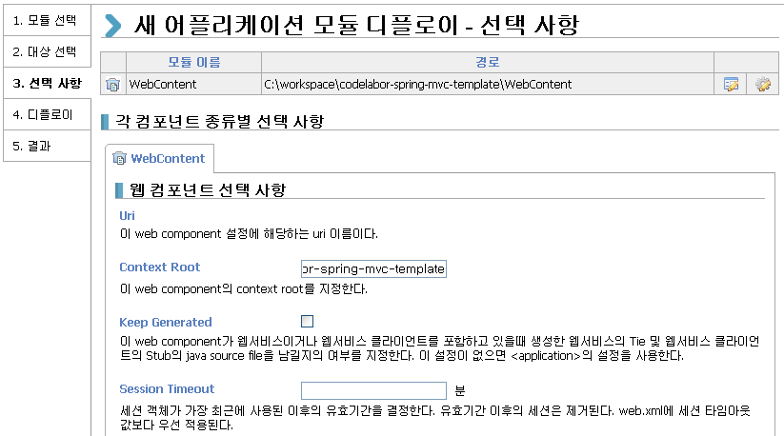
Jeus
Deploy Web Application
Set Context Root Name
Context Root: codelabor-spring-mvc-template

Slide 12
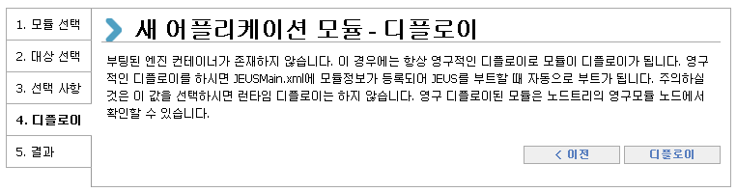
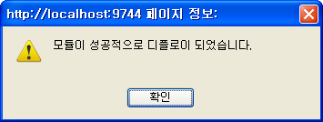
Jeus
Deploy Web Application
Deploy

Slide 13
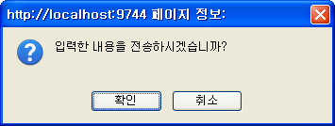
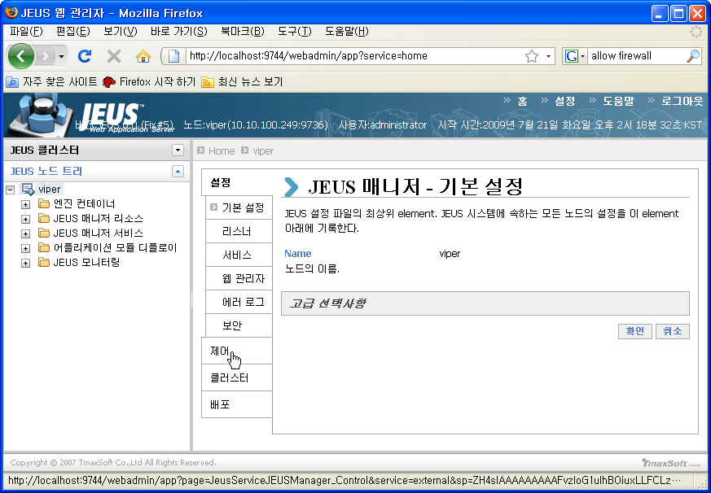
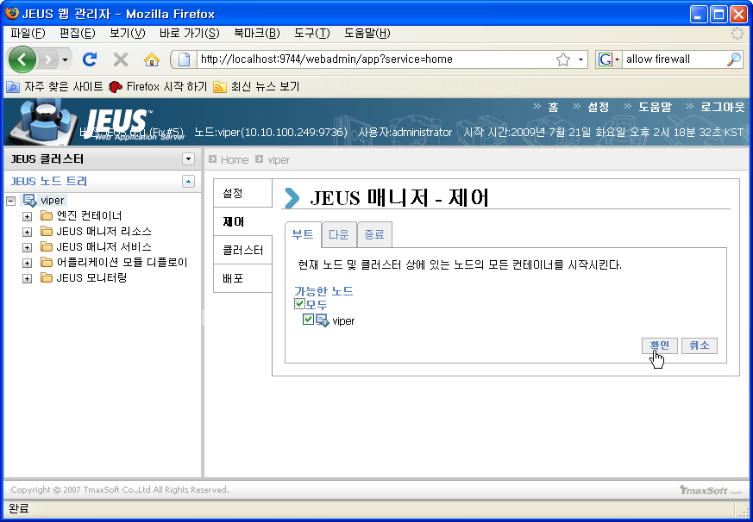
Jeus
Boot Node
Left Pan: Selet Node Name
Right Pan: Select 제어
부트 Tab: Check Node Name
Confirm

Slide 14
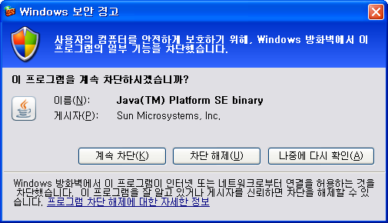
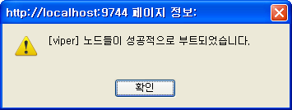
Jeus
Boot Node
Allow Firewall

Slide 15
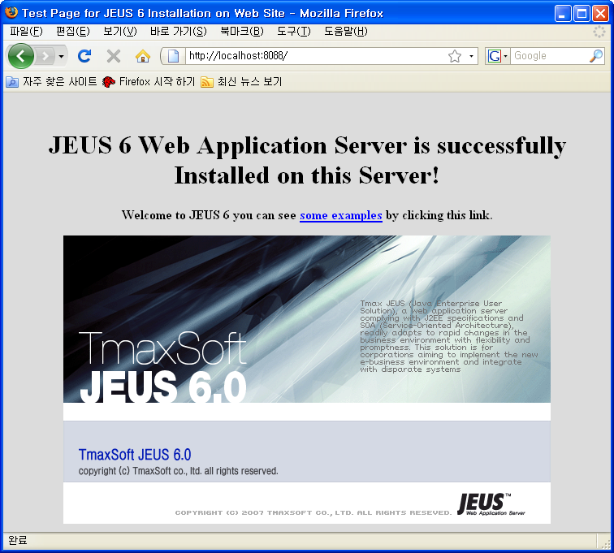
Jeus
Web Application
Browse Default Application
URL: http://localhost:8088/

Slide 16
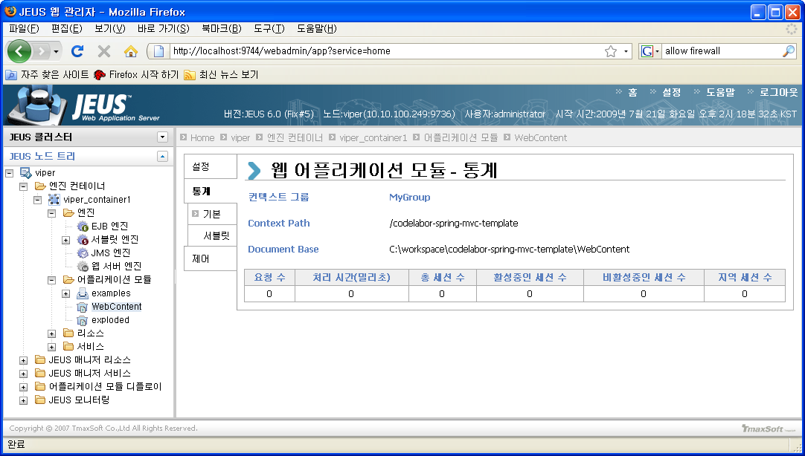
Jeus
Web Application
Browse Deployed Web Application
Node Name > 엔진 컨테이너 > nodename_container1 > 어플리케이션 모듈

Slide 17
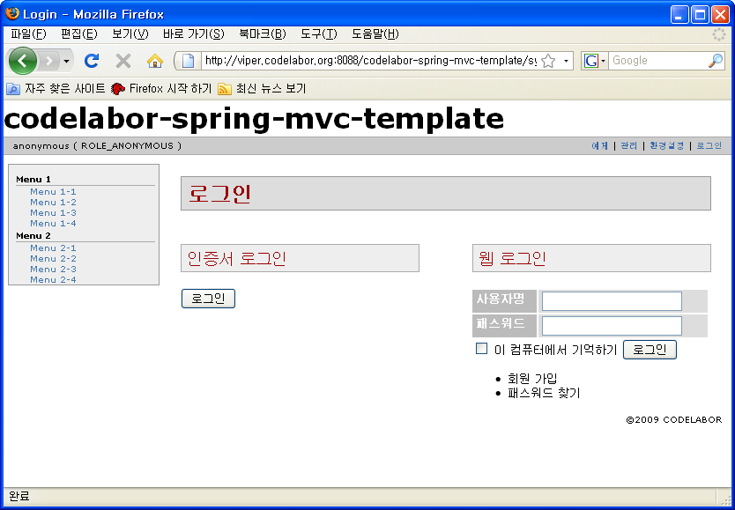
Jeus
Web Application
Browse Web Application
URL: http://localhost:8088/codelabor-spring-mvc-template

